Slide 1
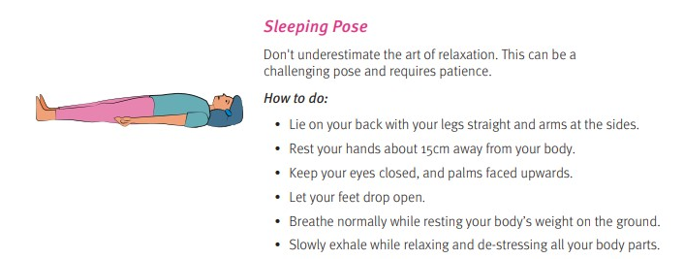
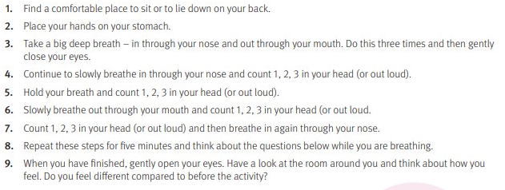
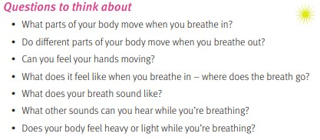
#WELLNESS WEDNESAY
Mindful Breathing
Mindful Breathing can be used as a relaxing way to start or end your day. Please take some time today and throughout this week to try the Mindful breathing exercise below.
Show us your pose! @KnowsleySSP
#WellnessWednesday MerseysideSGO

